Slide 1
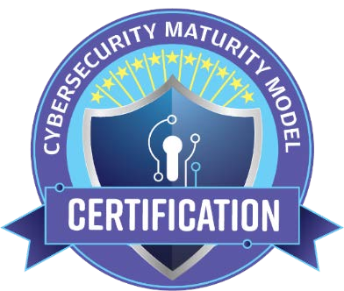
Cybersecurity Maturity Model Certification (CMMC)
CMMC Model v1.0
31 January 2020
Original: 米国国防総省（Department of Defence: DoD）
https://www.acq.osd.mil/cmmc/index.html
→黄は某氏超訳（どかせばオリジナル英文）
DISTRIBUTION A. Approved for public release

Slide 2





















Without a Secure Foundation All Functions are at Risk
安全な基盤がなければ
すべての機能はリスクに晒される
費用、期間、性能は
セキュアな環境があってこそ機能する
Cost, Schedule, and Performance
are only effective in a SECURE ENVIRONMENT
Performance
Performance
Cybersecurity
Schedule
Schedule
Cost
Cost
CYBERSECURITY

Slide 3
CMMC Model v1.0 Overview
CMMCは将来のDoDのための、統一されたサイバーセキュリティ標準である
CMMC is a unified cybersecurity standard for future DoD acquisitions
CMMC Model v1.0 encompasses the following:
17 capability domains; 43 capabilities
5 processes across five levels to measure process maturity
171 practices across five levels to measure technical capabilities
CMMCモデルv1.0には下記項目が含まれる
- 17の機能領域(ドメイン)、43の機能
- 5つのプロセス：プロセスの成熟度測定（5段階）
- 171のプラクティス：技術的能力測定（5段階）
CMMC Model v1.0: Number of Practices and Processes Introduced at each Level
CMMC Level | Practices | Processes
Level 1 | 17 | -
Level 2 | 55 | 2
Level 3 | 58 | 1
Level 4 | 26 | 1
Level 5 | 15 | 1

Slide 4
CMMC Model Framework
Model
Domains
Model encompasses multiple domains
Processes
For a given domain, there are processes that span a subset of the 5 levels
Capabilities
For a given domain, there are one or more capabilities that span a subset of the 5 levels
Practices
For a given capability, there are one or more practices that span a subset of the 5 levels
CMMC model framework organizes processes and cybersecurity best practices into a set of domains
Process maturity or process institutionalization characterizes the extent to which an activity is embedded or ingrained in the operations of an organization. The more deeply ingrained an activity, the more likely it is that:
An organization will continue to perform the activity – including under times of stress – and
The outcomes will be consistent, repeatable and of high quality.
Practices are activities performed at each level for the domain
・CMMCモデルフレームワークは、プロセスとサイバーセキュリティのベストプラクティスを一連の領域に組み込む
- プロセスの成熟度またはプロセスの制度化は、(セキュリティ)活動が組織の運用に組み込まれているまたは浸透している範囲を特徴付ける。活動が深く浸透しているほど、次のようになる。
- 組織は、ストレス(圧力)時を含め、活動を継続して実行する。
- 結果は、一貫性があり、再現性があり、高品質である。
‐ プラクティスは、ドメインの各レベルで実行される活動である。

Slide 5
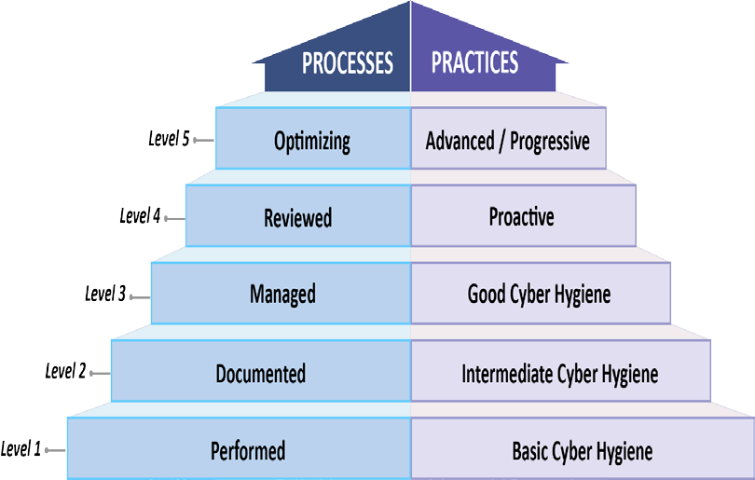
CMMC Model Structure
17の機能ドメイン(V1.0)
CMMC Model with 5 levels measures cybersecurity maturity
17 Capability Domains (v1.0)
Access Control (AC)
Incident Response (IR)
Risk Management (RM)
アクセス制御
(AC)
問題対応
(IR)
リスク管理
(RM)
Asset Management (AM)
Maintenance (MA)
Security Assessment (CA)
資産管理
(AM)
メンテナンス
(MA)
セキュリティ評価(CA)
Awareness and Training
(AT)
Media Protection (MP)
Situational Awareness (SA)
トレーニングと気付き（AT）
媒体保護
(MP)
状況認識
(SA)
Audit and Accountability (AU)
Personnel Security (PS)
System and Communications Protection (SC)
監査と
説明責任
（AU）
人事セキュリティ（PS）
システムと通信の保護(SC)
Configuration Management (CM)
Physical Protection (PE)
System and Information Integrity (SI)
構成管理
(CM)
物理防御
(PE)
システムと情報の整合性
（SI）
Identification and Authentication (IA)
Recovery (RE)
認証と認可
(IA)
復旧
(RE)

Slide 6

CMMC Maturity Process Progression
LEVEL 5
OPTIMIZING
LEVEL 4
LEVEL 3
REVIEWED
5 PROCESSES
Each practice is documented,
LEVEL 2
MANAGED
DOCUMENTED
4 PROCESSES
Each practice is documented,
including lower levels
LEVEL 1
3 PROCESSES
Each practice is documented, including lower levels
PERFORMED
including lower levels
A policy exists that covers all activities
2 PROCESSES
Each practice is documented, including Level 1 practices
A policy exists that covers all activities
0 PROCESSES
Select practices are documented where required
A plan exists that includes all activities*
A policy exists that cover all activities
A plan exists that includes all activities*
Activities are reviewed and measured for effectiveness
A policy exists that includes all activities
A plan exists, is maintained, and resourced that includes all activities*
Activities are reviewed and measured for effectiveness (results of the review is shared with higher level management)
There is a standardized, documented approach across all applicable organizational units
*Planning activities may include mission, goals, project plan, resourcing, training needed, and involvement of relevant stakeholders

Slide 7
CMMC Practice Progression
LEVEL 5
ADVANCED / PROGRESSIVE
LEVEL 4
LEVEL 3
PROACTIVE
LEVEL 2
INTERMEDIATE CYBER
171 PRACTICES
Comply with the FAR
GOOD CYBER HYGIENE
156 PRACTICES
Encompasses all practices from NIST
LEVEL 1
HYGIENE
130 PRACTICES
Comply with the FAR
SP 800-171 r1
BASIC CYBER HYGIENE
72 PRACTICES
Comply with the FAR
Encompasses all practices from NIST SP 800-171 r1
Includes a select subset of 4 practices from Draft NIST SP 800-171B
17 PRACTICES
Comply with the FAR
Encompasses all practices from NIST SP 800-171 r1
Equivalent to all practices in Federal Acquisition Regulation (FAR) 48 CFR 52.204- 21
Includes a select subset of 48 practices from the NIST SP 800- 171 r1
Includes a select subset of 11 practices from Draft NIST SP 800-171B
Includes an additional 11 practices to demonstrate an advanced cybersecurity program
Includes an additional 20 practices to support good cyber hygiene
Includes an additional 7 practices to support intermediate cyber hygiene
Includes an additional 15 practices to demonstrate a proactive cybersecurity program

Slide 8



CMMC Practices Per Level
LEVEL 5
ADVANCED / PROGRESSIVE
LEVEL 4
PROACTIVE
156 PRACTICES
171 PRACTICES
+ 15 Practices
LEVEL 3
GOOD CYBER HYGIENE
130 PRACTICES
+ 26 Practices
+ 58 Practices
LEVEL 2
INTERMEDIATE CYBER HYGIENE
72 PRACTICES
LEVEL 1
BASIC CYBER HYGIENE
17 PRACTICES + 55 Practices
DISTRIBUTION A. Approved for public release

Slide 9
CMMC Model v1.0 Source Counts
Model leverages multiple sources and references
CMMC Level 1 only addresses practices from FAR Clause 52.204-21
CMMC Level 3 includes all of the practices from NIST SP 800-171r1 as well as others
CMMC Levels 4 and 5 incorporate a subset of the practices from Draft NIST SP 800-171B plus others
Additional sources, such as the UK Cyber Essentials and Australia Cyber Security Centre Essential Eight Maturity Model, were also considered and are referenced in the model
Draft CMMC Model v1.0: Number of Practices per Source
CMMCモデルは複数の情報元を参照し、活用する
- CMMCレベル1は、FAR条項52.204-21のプラクティスのみに対応している
- CMMCレベル3には、NIST SP 800-171r1およびその他のすべてのプラクティスが含まれる
- CMMCレベル4および5には、ドラフトNIST SP 800-171Bに加えてその他のプラクティスのサブセットが組み込まれている
- UK Cyber EssentialsやAustralia Cyber Security Center Essential Eight Maturity Modelなどの追加ソースも検討され、モデルで参照されている
CMMC Level | Total Number Practices Introduced per CMMC Level | Source
 |  | 48 CFR 52.204-21 | NIST SP 800-171r1 | Draft NIST SP 800-171B ** | Other
Level 1 | 17 | 15* | 17* | - | -
Level 2 | 55 | - | 48 | - | 7
Level 3 | 58 | - | 45 | - | 13
Level 4 | 26 | - | - | 11 | 15
Level 5 | 15 | - | - | 4 | 11
* Note: 15 safeguarding requirements from FAR clause 52.204-21 correspond to 17 security requirements from NIST SP 800-171r1, and in turn, 17 practices in CMMC
** Note: 18 enhanced security requirements from Draft NIST SP 800-171B have been excluded from CMMC Model v1.0

Slide 10
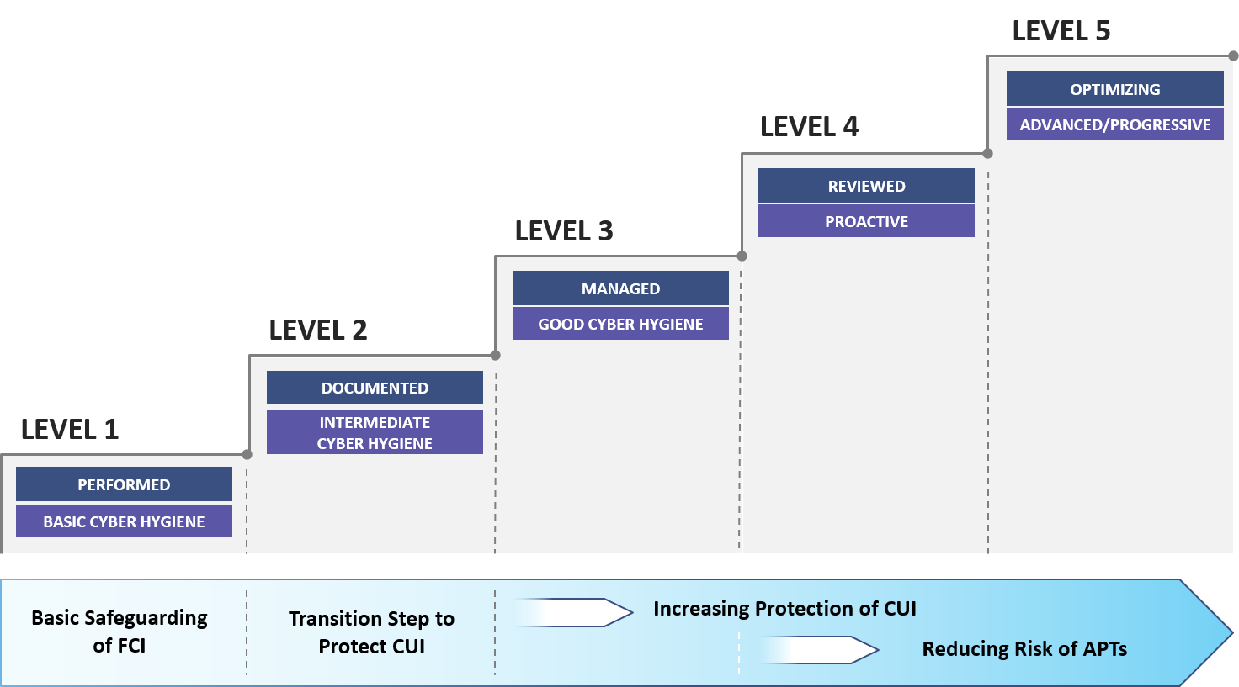
Summary
CMMC establishes cybersecurity as a foundation for future DoD acquisitions
CMMC levels align with the following focus:
Level 1: Basic safeguarding of FCI
Level 2: Transition step to protect CUI
Level 3: Protecting CUI
Levels 4-5: Protecting CUI and reducing risk of APTs
・CMMCは将来のDoDのための
統一されたサイバーセキュリティを確立する
・CMMCは下記焦点のレベルと一致する
- Level 1: Basic safeguarding of FCI(*)
- Level 2: Transition step to protect CUI(*)
- Level 3: Protecting CUI
- Levels 4-5: Protecting CUI and reducing risk of APTs(*)
* FCI: Federal Contract Information
連邦契約情報
* CUI: Controlled Unclassified Infomation
管理されていない機密情報
* APT: Advanced Persistent Threat
持続的標的型攻撃

Slide 11
Backups

Slide 12
Supporting Documentation Summary
CMMC Model v1.0 document consists of the following:
Introduction, CMMC Model, and Summary
Appendix A: CMMC Model v1.0
Appendix B: Process and Practice Descriptions
Appendix C: Glossary
Appendix D: Abbreviations and Acronyms
Appendix E: Source Mapping
Appendix F: References

Slide 13
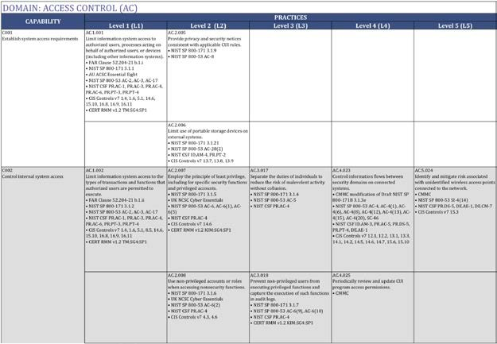
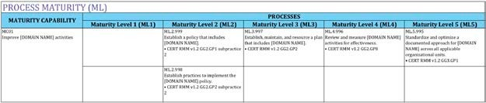
Appendix A: CMMC Model v1.0
Appendix A provides the model in tabular form with all practices organized by Domain (DO), Capability, and Level (L)
Practices are numbered as DO.L.###, with a unique number ###
Each practice includes up to nine sources
Appendix A also includes maturity level processes
Processes are generalized but apply to all domains
Processes are numbered as ML.L.99#
Appendix A Practices
Appendix A Processes

Slide 14

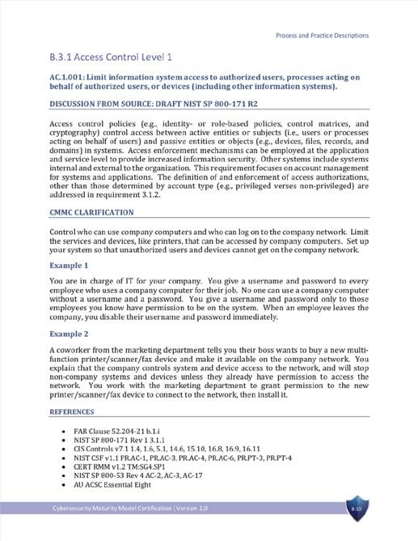
Appendix B: Process and Practice Descriptions
Appendix B Process and Practice Descriptions include:
Discussion, derived from source material where available
Clarification with examples
A list of references
Same framework as model
Processes are generalized but apply to all domains
Practices are ordered by domain and level
Appendix B Practice & Process Descriptions

Slide 15

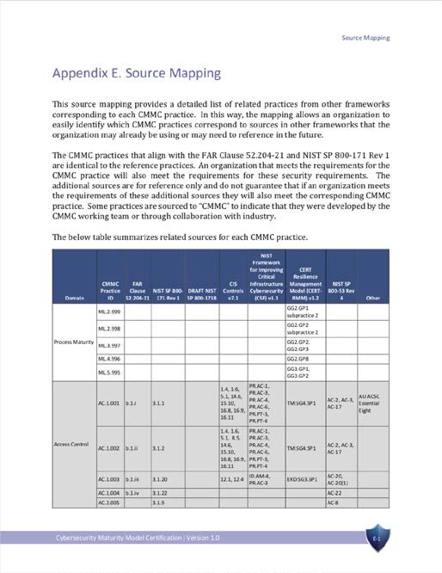
Appendix E: Source Mapping
Appendix E Source Mapping summarizes the list of sources for all five processes and 171 practices
Sources include:
FAR Clause 52.204-21
NIST SP 800-171 Rev 1
Draft NIST SP 800-171B
CIS Controls v7.1
NIST Framework for Improving Critical Infrastructure Cybersecurity (CSF) v1.1
CERT Resilience Management Model (CERT RMM) v1.2
NIST SP 800-53 Rev 4
Others such as CMMC, UK NCSC Cyber Essentials, or AU ACSC Essential Eight
Appendix E Source Mapping

